Slide 1



Learning in Factored Domains with Information-Constrained Visual Representations — Speaker: Tyler Malloy Authors: Tyler Malloy, Tim Klinger, Miao Liu, Matthew Riemer, Gerald Tesauro, Chris R. Sims Rensselaer Polytechnic Institute IBM Research AI
Research AI
Notes:
Hello, the title of this presentation is learning in factored domains with information constrained visual representations, my name is tyler malloy

Slide 2
Motivation
Reinforcement learning methods typically require long training periods.
Notes:
Reinforcement learning methods typically require long periods of training in a single environment to achieve good performance, and don’t easily transfer their learning to other domains.

Slide 3
Motivation
Reinforcement learning methods typically require long training periods.
Humans learn quickly in complex tasks in part due to:
Notes:
Meanwhile, humans are able to learn quickly in complex tasks in part due to their ability to…

Slide 4
Motivation
Reinforcement learning methods typically require long training periods.
Humans learn quickly in complex tasks in part due to:
Compressed and disentangled representations.
Notes:
Learn efficient representations of complex information that encode information in a disentangled manner…

Slide 5
Motivation
Reinforcement learning methods typically require long training periods.
Humans learn quickly in complex tasks in part due to:
Compressed and disentangled representations.
General hypothesis generation and evaluation.
Notes:
And the ability to generate and evaluate hypotheses that can explain their experience.

Slide 6
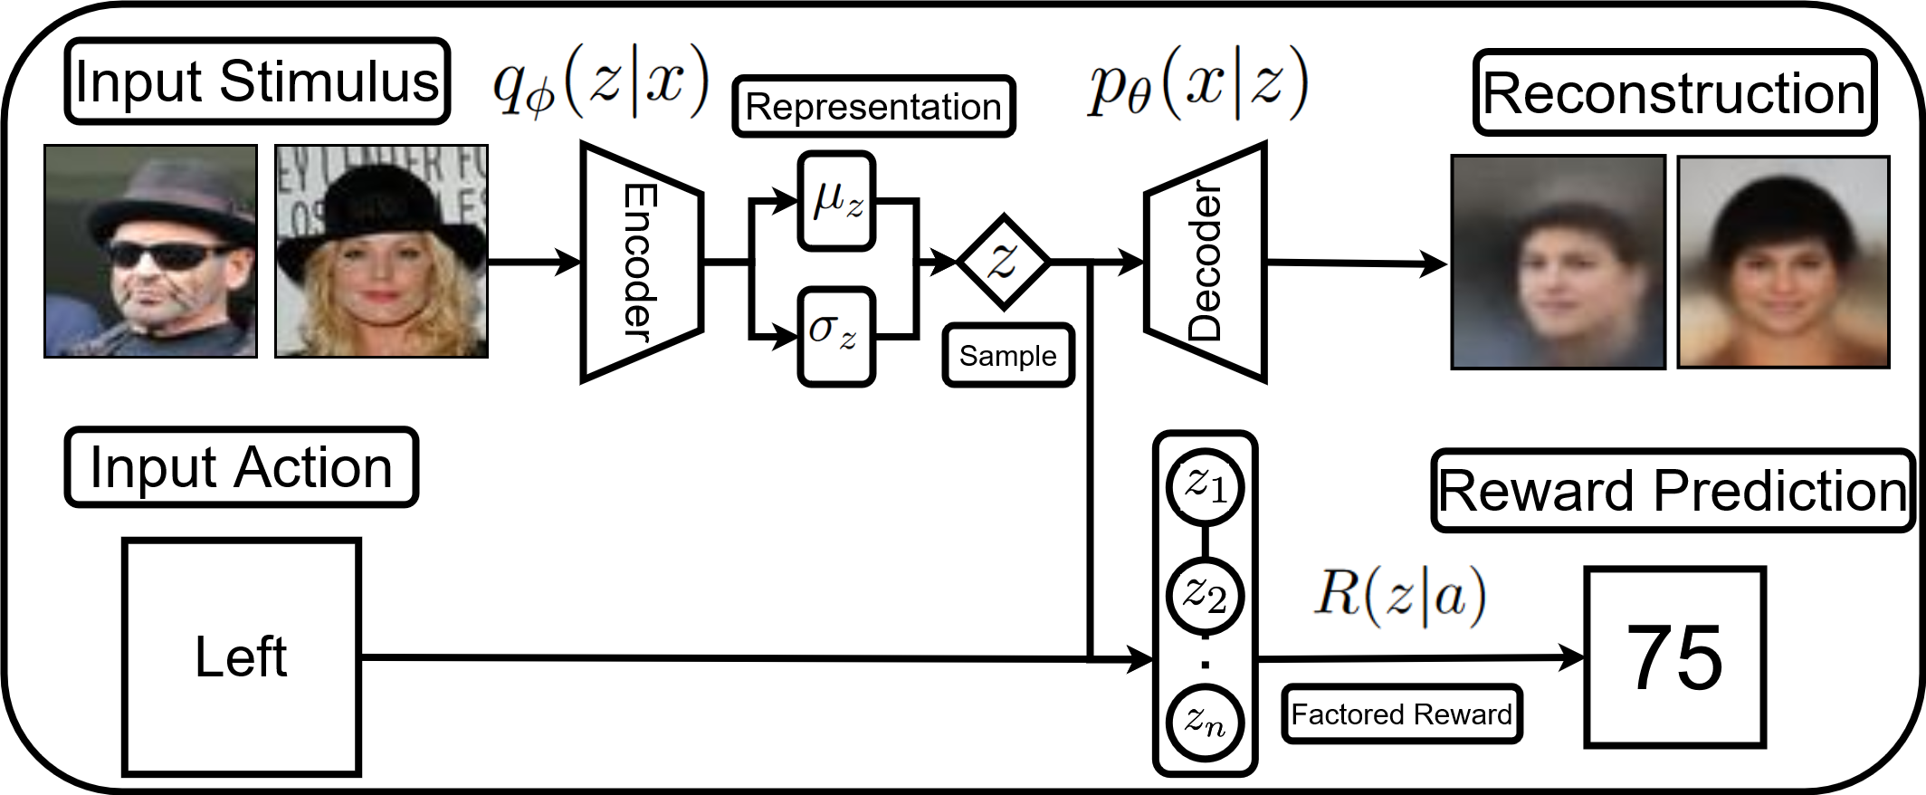
Beta–Variational Auto Encoder
Notes:
One approach to developing efficient and disentangled representations of visual information is the use of beta-variational auto-encoders…

Slide 7
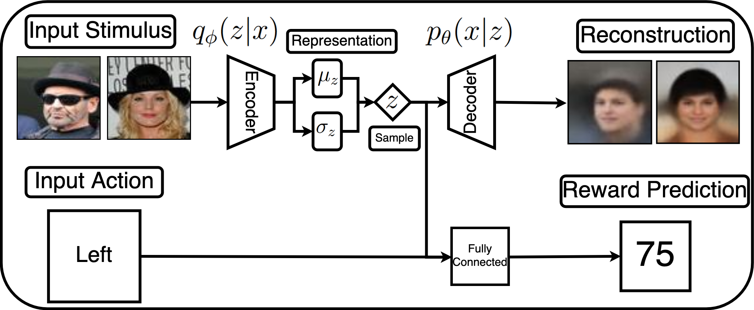
Reinforcement Learning Beta–Variational Auto Encoder
Notes:
These models have been previously combined with reinforcement learning methods to demonstrate high transfer learning, however they can still lag behind the fast learning of humans in some domains, and are not closely connected to how humans hypothesize…

Slide 8
Reinforcement Learning Beta–Variational Auto Encoder
Notes:
To address this we developed a Reinforcement Learning B-VAE model that learns efficient and disentangled representations of visual information that are fed into a separate hypothesis generation and evaluation method by assuming a factored reward function…

Slide 9
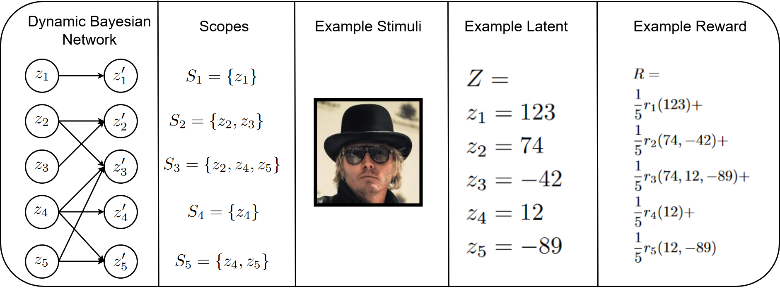
Hypothesis Generation and Evaluation
Factored structure defined by Dynamic Bayesian Network.
DBN consists of latent features instead of the state.
Describes the dependency of previous latent features and subsequent, as well as the factored reward function.
Notes:
The hypothesis generation and evaluation method assumes a factored dependency structure, described by a dynamic Bayesian network with nodes corresponding to latent representation features.

Slide 10
Hypothesis Generation and Evaluation
A set of scopes is a possible hypothesis, which describes the causal structure.
Scopes are generated to be informationally simple.
Accuracy of scopes is evaluated based on accuracy to previous experience.
Notes:
A possible scope describes one hypothesis corresponding to an assignment of these dependencies.
Hypotheses are generated to prefer simple explanations of state dependencies and evaluated based on how well they predict experience.

Slide 11
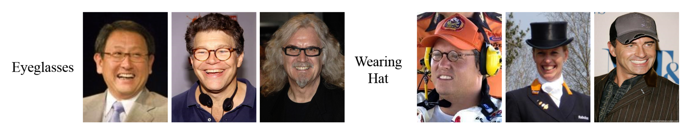
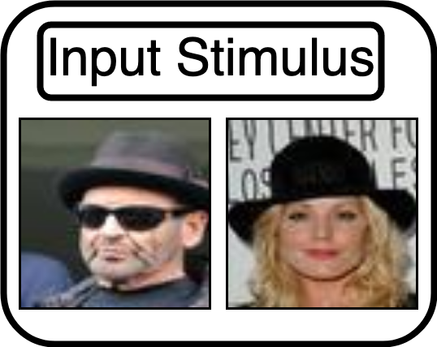
Environment
Contextual N-Armed bandit with human face images.
Glasses worth 25 points.
Hats worth 50 points.
Both are worth 75 points.
Neither worth 0 points.
Notes:
The environment used for testing consists of a simple contextual n-armed bandit, with the following reward structure…

Slide 12
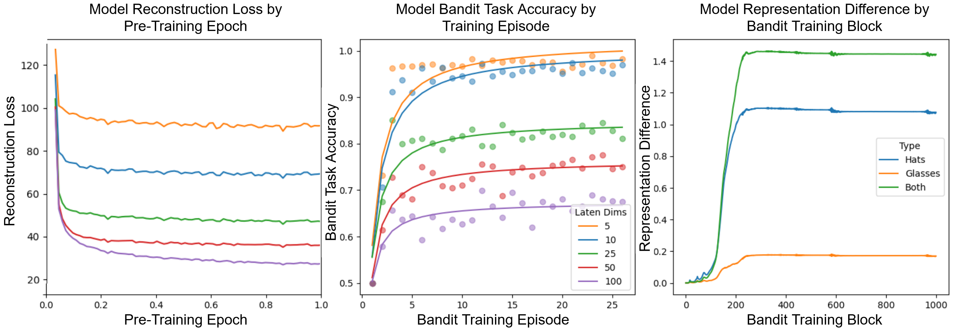
Modelling Results
Notes:
Results from a comparison of different latent representation sizes demonstrates a trade-off in representation complexity, between the accuracy of stimuli reconstructions and the speed of learning.
Learning with small representation sizes allows the model to select the option with a higher reward after only two experiences in the environment, but results in less accurate reconstructions.

Slide 13
Representation Analysis
Comparing representation similarity of 3 non-zero value groups to images with neither hats nor glasses.
As utility is learned, representations are differentiated based on the scale of the utility difference.
Notes:
Comparing representations as the model gains experience in the environment demonstrates an adjustment of representation similarity, as utility is learned the model represents stimuli with similar utility as being more similar.

Slide 14
Conclusions
Disentangled and information-constrained representation formation is useful for transfer learning and generalization.
How is information represented in the reinforcement learning faculty of the human mind?
Notes:
These results have direct implications on how human’s visual information processing can leverage information constraints to achieve high generalization and fast learning in a wide variety of environments.
Additionally, this work furthers our understanding of the question of how information is represented in the reinforcement learning faculty of the human mind, which can be further studied in the future.

Slide 15
Thank you for your attention!!
Notes:
Thank you for your attention!

